Slide 1

July 18, 2024
Bayesian Model Calibration

Slide 2
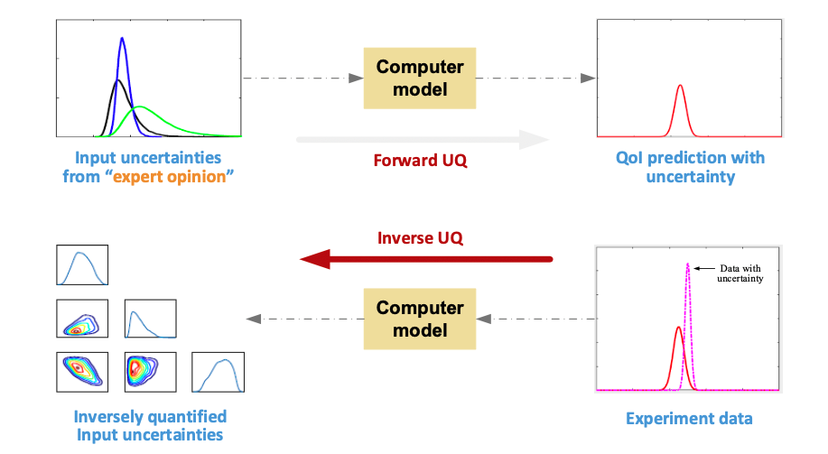
Forward UQ vs. Inverse UQ
* X. Wu, Inverse uncertainty quantification, 2020

Slide 3
Model Calibration (Inverse UQ)
Motivation
To address the “missing input uncertainty information” issue
To develop a rigorous method to infer the uncertainties in input parameters
The process to inversely quantify input uncertainties based on simulation and experimental data
Objective
Capture the input uncertainties, rather than the best-fit point estimates
Avoid over-fitting via explicitly considers model uncertainty
Reduce computational cost through machine learning techniques

Slide 4
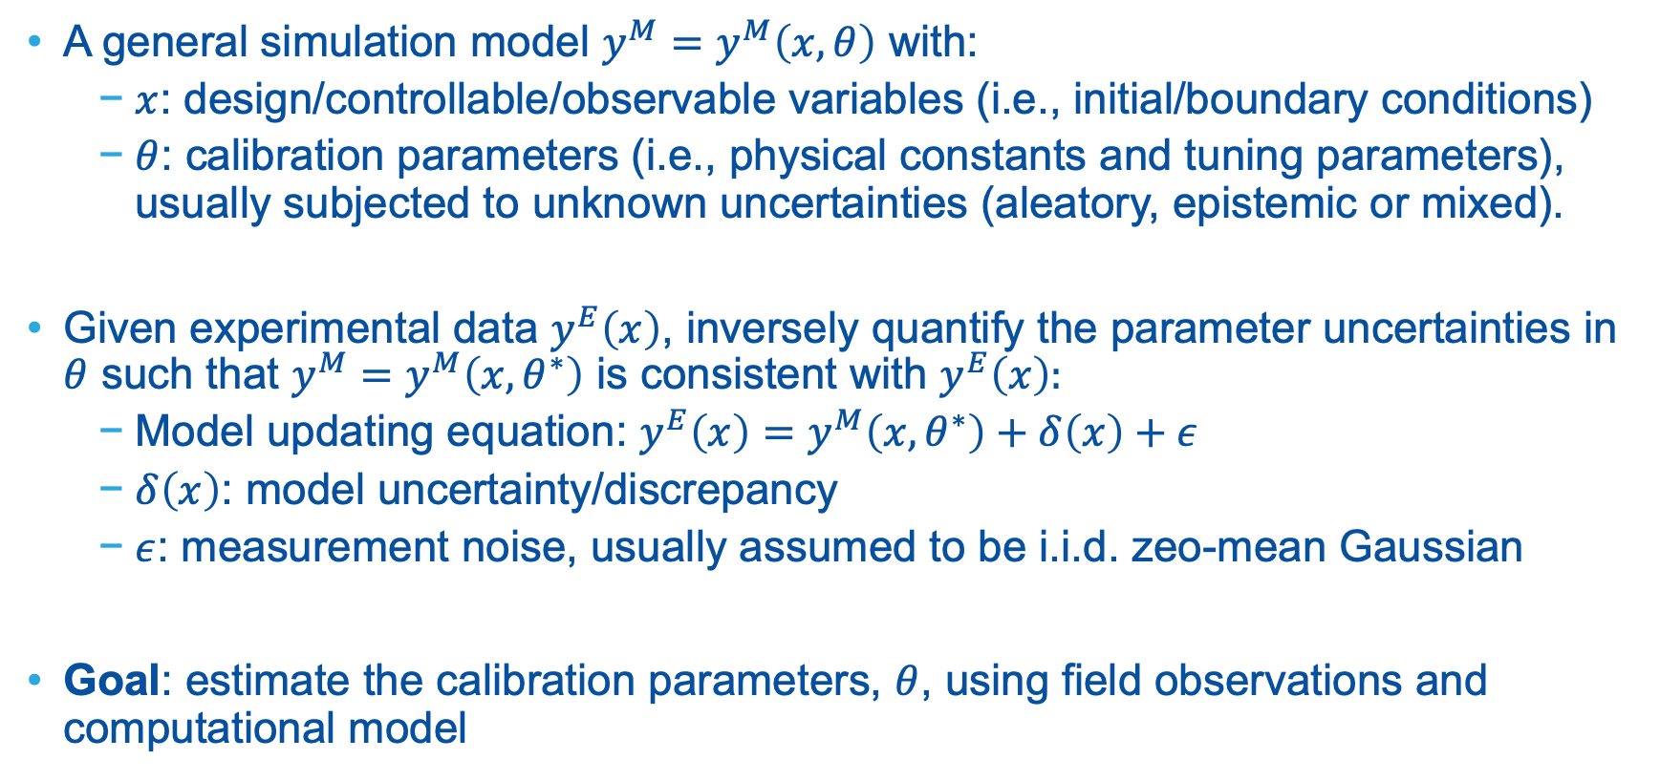
Problem Definition: Role of Model Calibration
A general simulation model $y^{M}=y^{M}\left(x,θ\right)$ with:
$x$: design/controllable/observable variables (i.e., initial/boundary conditions)
$θ$: calibration parameters (i.e., physical constants and tuning parameters), usually subjected to unknown uncertainties (aleatory, epistemic or mixed).
Given experimental data $y^{E}\left(x\right)$, inversely quantify the parameter uncertainties in $θ$ such that $y^{M}=y^{M}\left(x,θ^{∗}\right)$ is consistent with $y^{E}\left(x\right):$
Model updating equation: $y^{E}\left(x\right)=y^{M}\left(x, θ^{∗}\right)+δ\left(x\right)+ε$
$δ\left(x\right)$: model uncertainty/discrepancy
$ε$: measurement noise, usually assumed to be i.i.d. zeo-mean Gaussian
Goal: estimate the calibration parameters, $θ$, using field observations and computational model

Slide 5
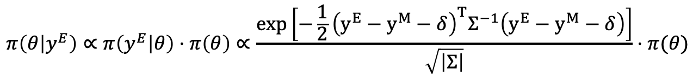
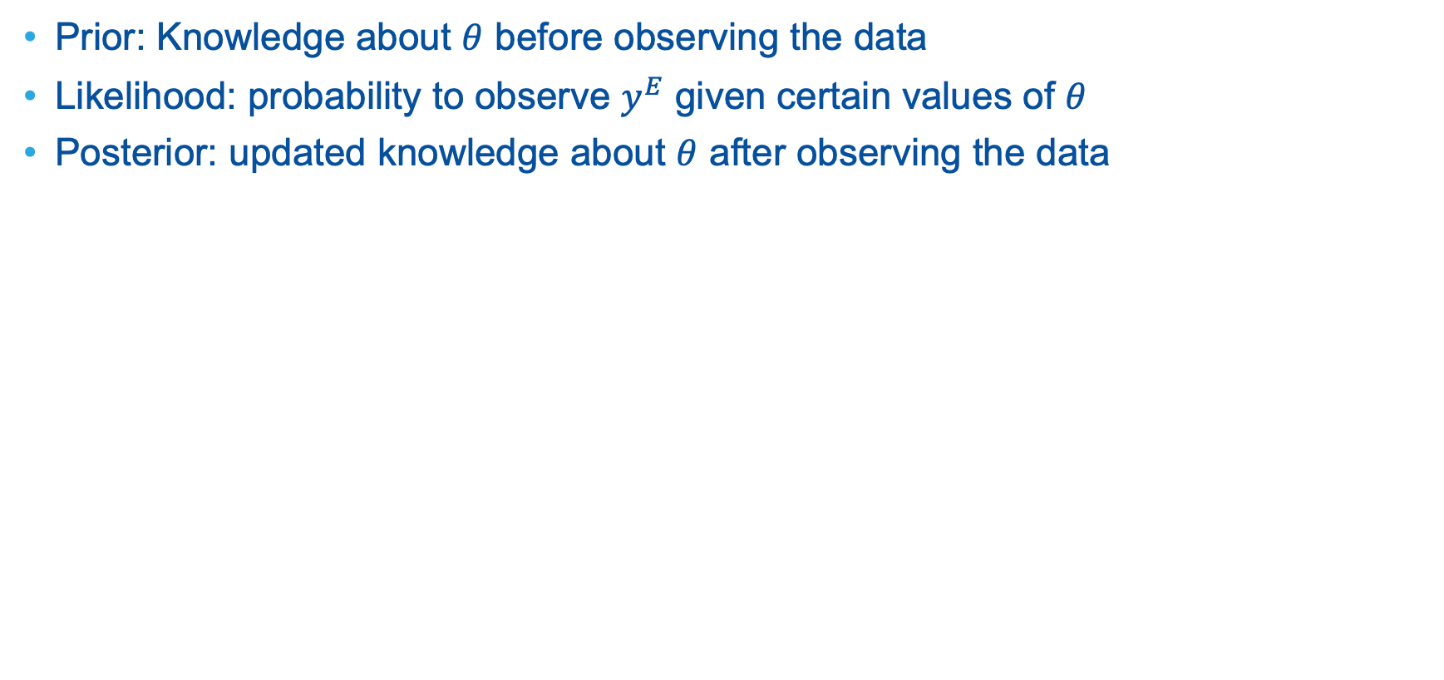
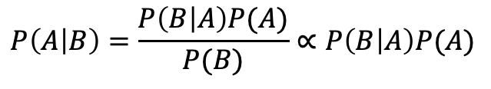
Bayesian Inference: Bayes’ Rule, Prior, Likelihood, Posterior
Prior: Knowledge about $θ$ before observing the data
Likelihood: probability to observe $y^{E}$ given certain values of $θ$
Posterior: updated knowledge about $θ$ after observing the data
Likelihood
Posterior
$$P\left(A | B\right)=\frac{P\left(B | A\right)P(A)}{P(B)}∝P\left(B | A\right)P(A)$$
Prior
$$π\left(θ | y^{E}\right)∝π\left(y^{E} | θ\right)⋅π\left(θ\right)∝\frac{\exp\left[−\frac{1}{2}{\left(y^{E}−y^{M}−δ\right)}^{T}Σ^{−1}\left(y^{E}−y^{M}−δ\right)\right]}{\sqrt{\left|Σ\right|}}⋅π(θ)$$

Slide 6
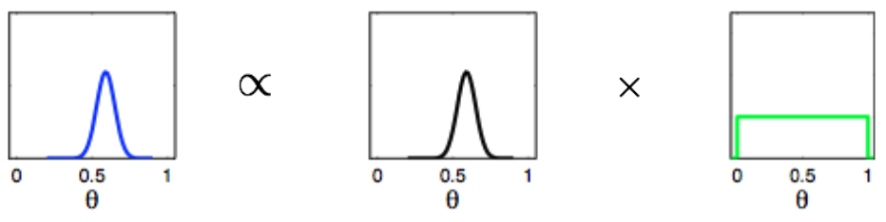
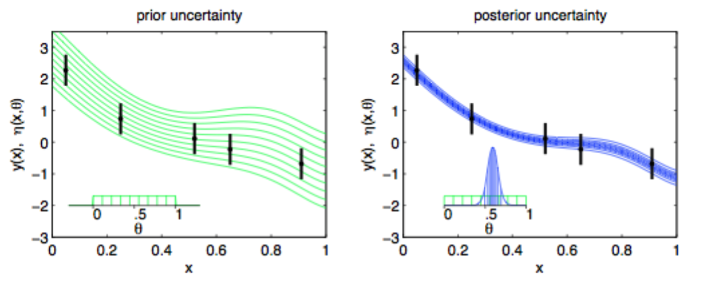
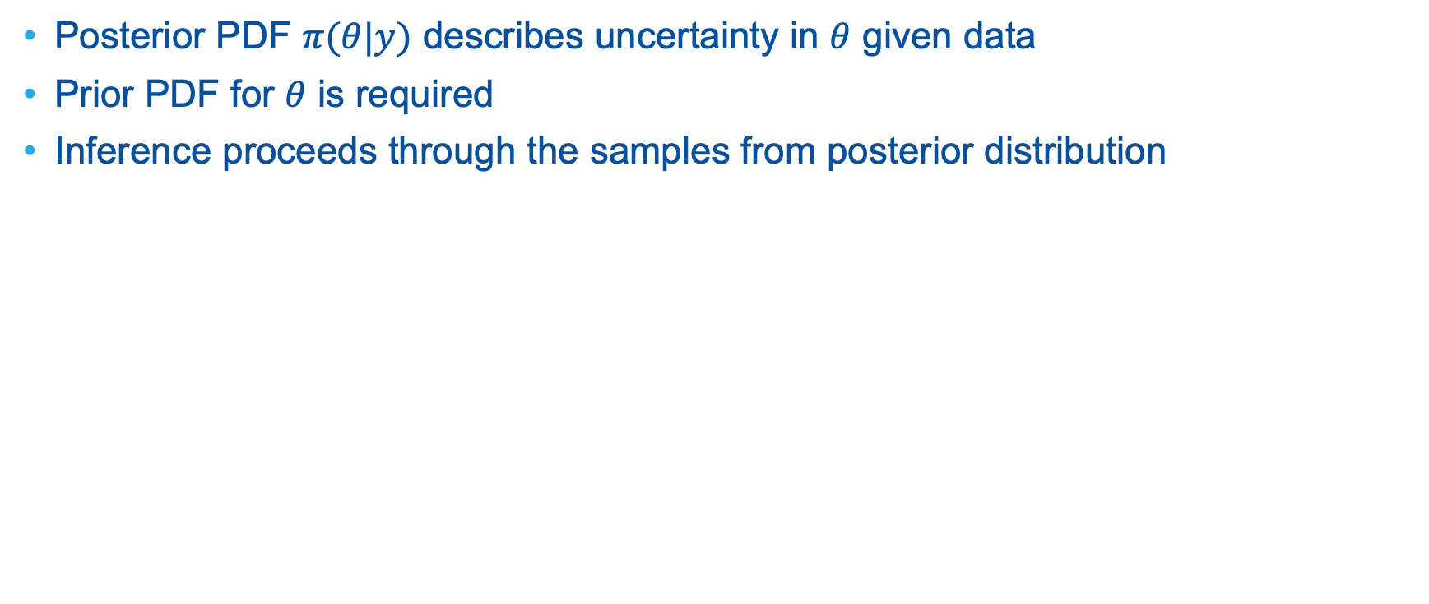
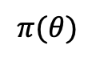
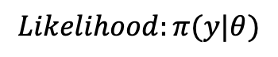
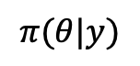
General Look at Bayes Rules
Posterior PDF $π(θ|y)$ describes uncertainty in $θ$ given data
Prior PDF for $θ$ is required
Inference proceeds through the samples from posterior distribution
$$π(θ|y)$$
$$Likelihood:π(y|θ)$$
$$π(θ)$$

Slide 7
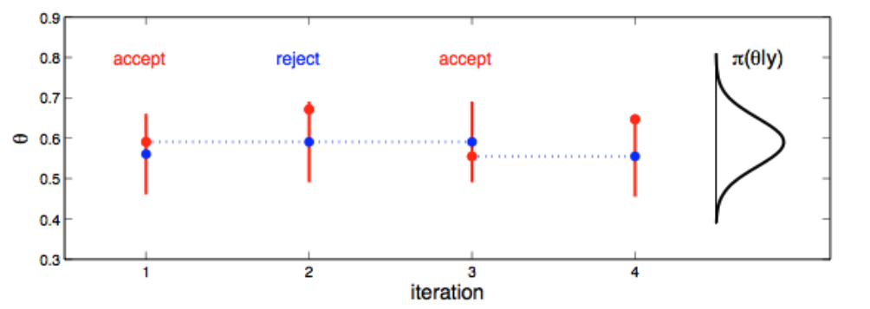
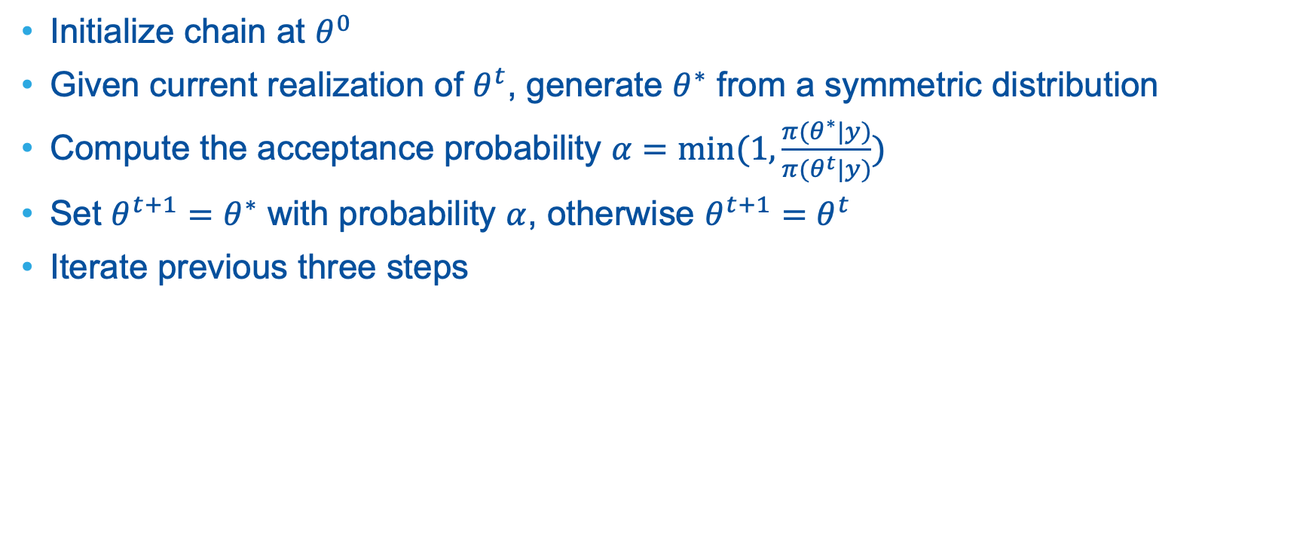
Metropolis-Hastings Recipe for MCMC
Initialize chain at $θ^{0}$
Given current realization of $θ^{t}$, generate $θ^{∗}$ from a symmetric distribution
Compute the acceptance probability $α=min⁡(1,\frac{π(θ^{∗}|y)}{π(θ^{t}|y)})$
Set $θ^{t+1}=θ^{∗}$ with probability $α$, otherwise $θ^{t+1}=θ^{t}$
Iterate previous three steps

Slide 8
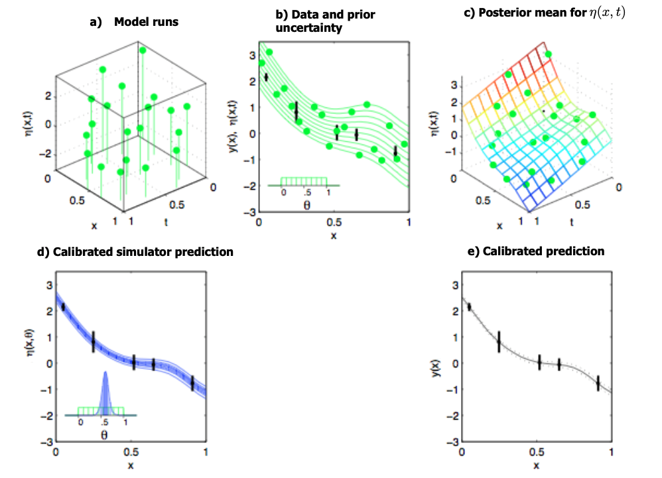
The Process of Model Calibration

Slide 10
Model Calibration Challenges
Challenge 1
Model calibration under uncertainty
Challenge 2
Holistic tool to perform sensitivity analysis, uncertainty quantification and model calibrations
Challenge 3
Computational expensive: requires thousands of simulations
Challenge 4
Slow convergence with high-dimensional input space and output space

Slide 11
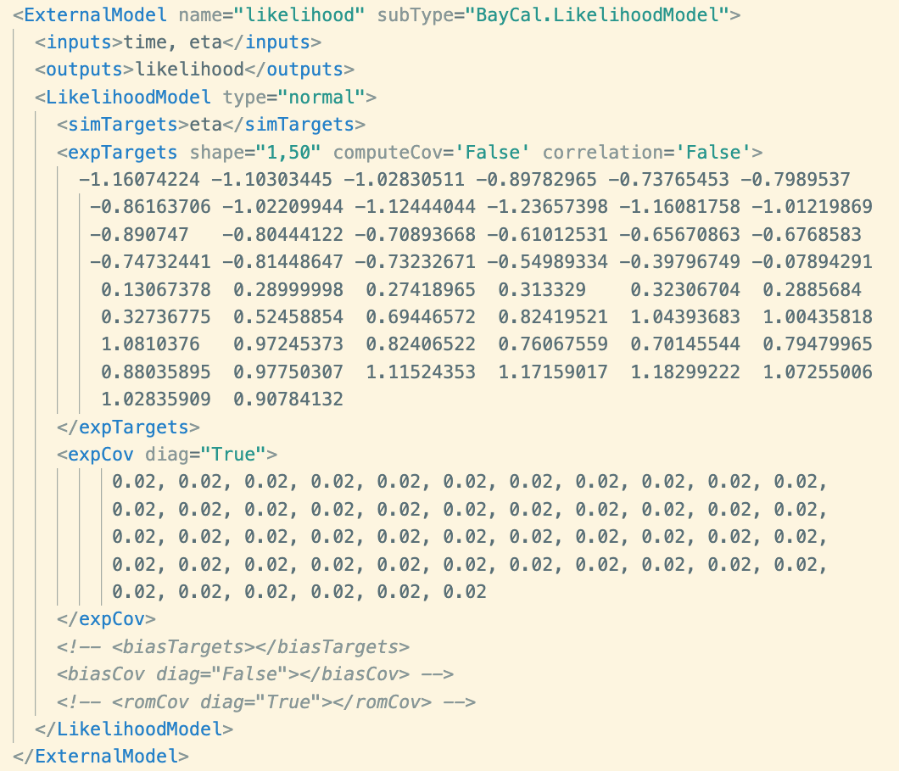
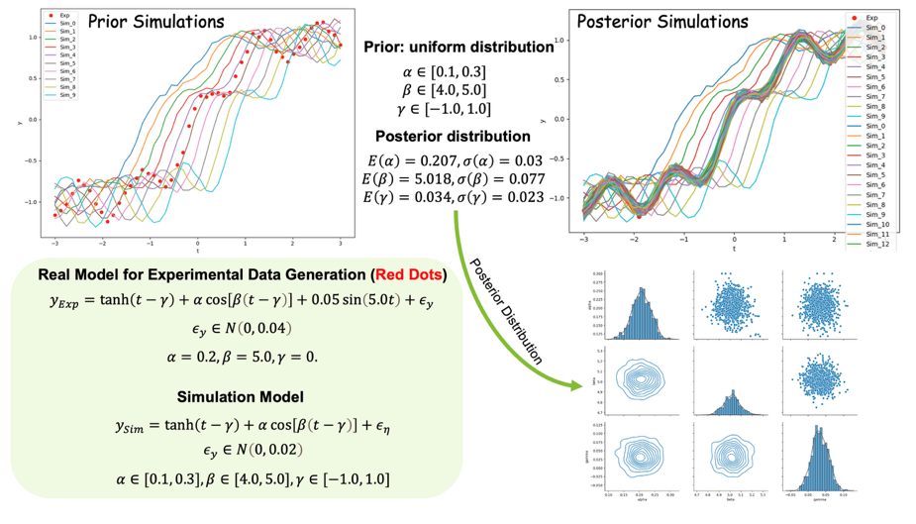
RAVEN Likelihood Model
https://github.com/idaholab/BayCal
https://baycal.readthedocs.io/en/latest/index.html#

Slide 12
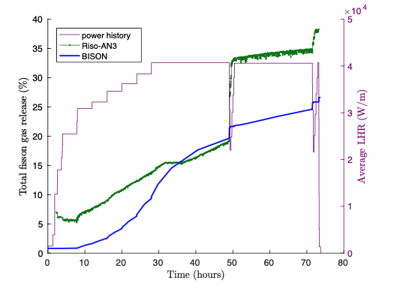
Fission Gas Release (FGR) and Problem Definition
Swelling, gap pressure build-up, thermal conductivity degradation
Significant inherent uncertainties in FGR modeling
The FGR model in BISON has 5 input parameters whose uncertainties are only known by “expert opinion”.

Slide 13
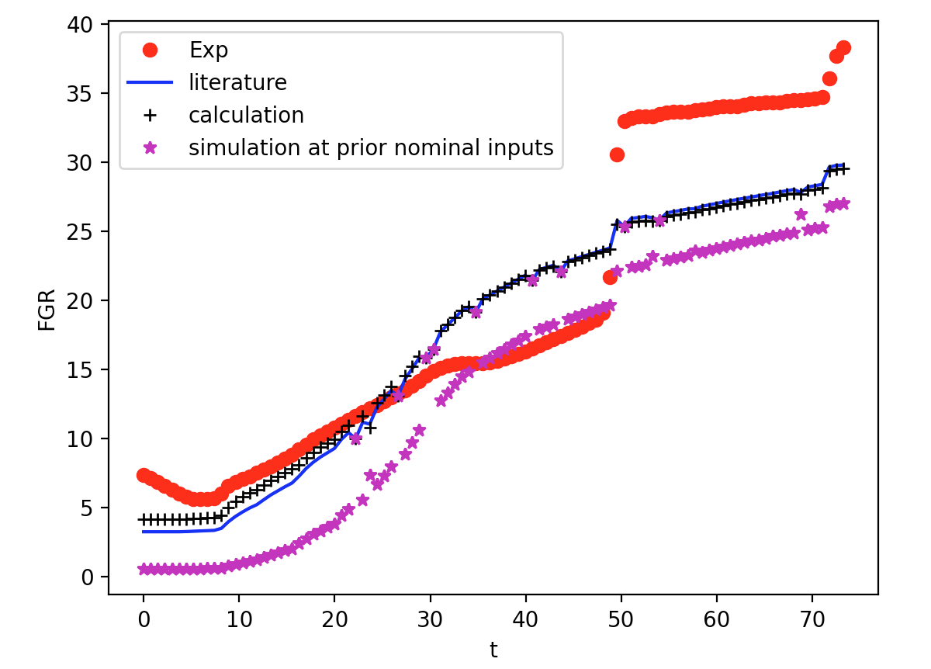
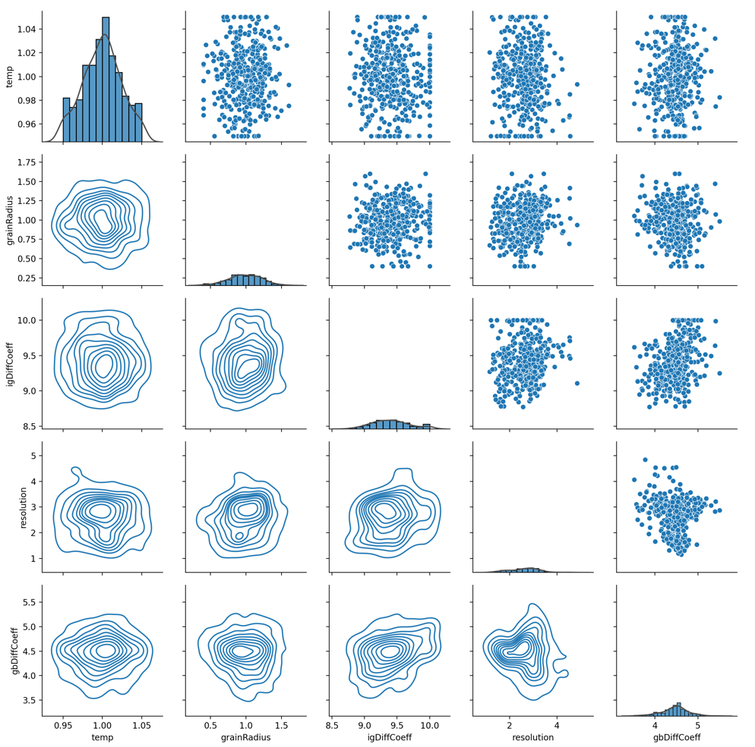
RAVEN Model Calibration
Markov Chain Monte Carlo
Metropolis-Hastings algorithm with dimensionality reduction
Adaptive Metropolis algorithm with dimensionality reduction
Riso AN3 Benchmark: https://mooseframework.inl.gov/bison/LWR/validation/Riso_AN3/doc/Riso_AN3.html

Slide 14
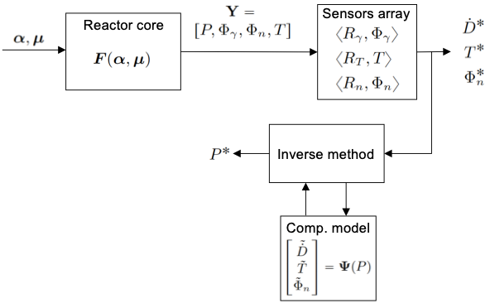
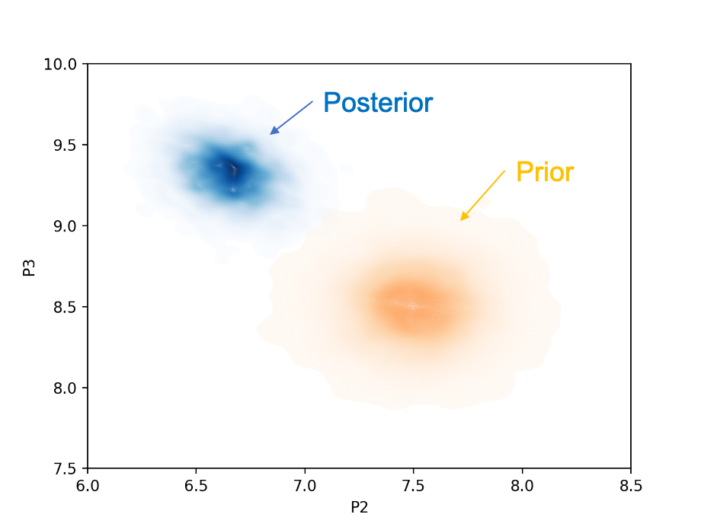
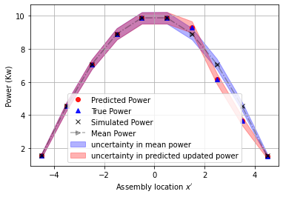
Application 2
Data analytics methods to integrate measured data and simulation models to reconstruct core power profile (i.e., solve the inverse problem)

